Slide 1
FLIGHT PRICE PREDICTION
SUBMITTED BY
Sachin Gupta

Slide 2
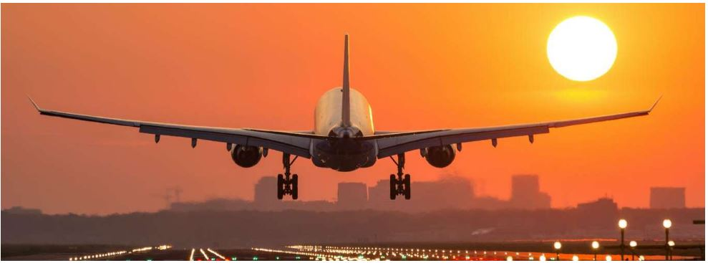

Slide 3
Introduction
The tourism industry is changing fast and this is attracting a lot more travelers each year. The airline industry is considered as one of the most sophisticated industry in using complex pricing strategies. Now-a-days flight prices are quite unpredictable. The ticket prices change frequently. Customers are seeking to get the lowest price for their ticket, while airline companies are trying to keep their overall revenue as high as possible. Using technology it is actually possible to reduce the uncertainty of flight prices. So here we will be predicting the flight prices using efficient machine learning techniques.

Slide 4
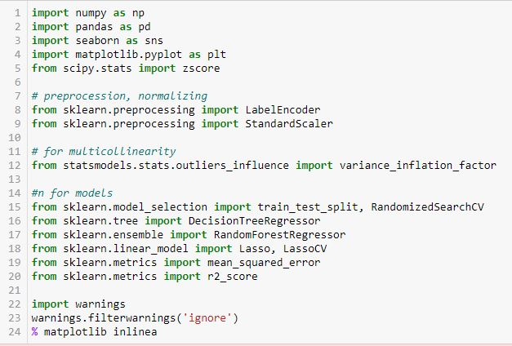
Importing Libraries

Slide 5
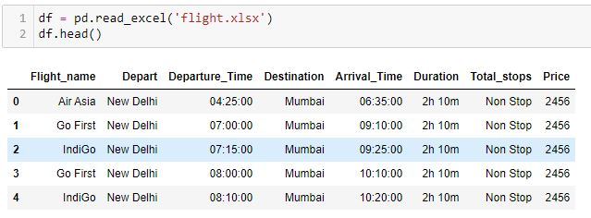
Loading excel data

Slide 6
EDA – Exploratory Data Analysis

Slide 7

CHECKING ROWS & COLUMNS

Slide 8
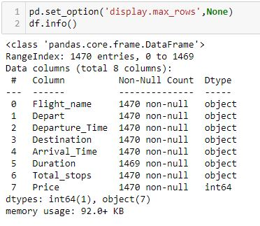
Checking columns type

Slide 9

Checking Duplicates

Slide 10
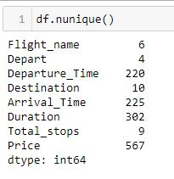
Checking Continuous & Categorical Columns

Slide 11
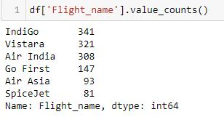
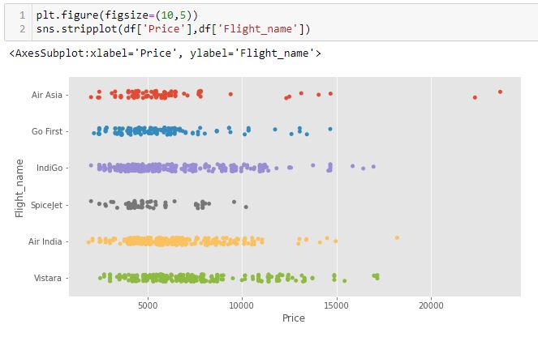
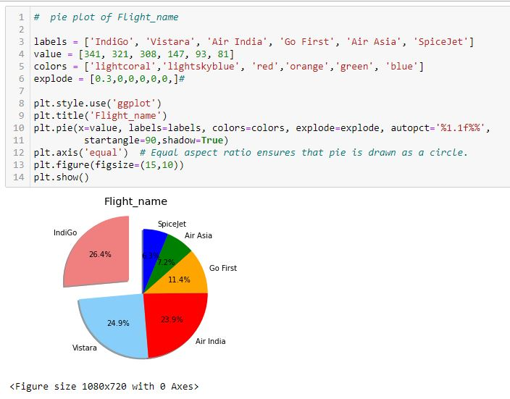
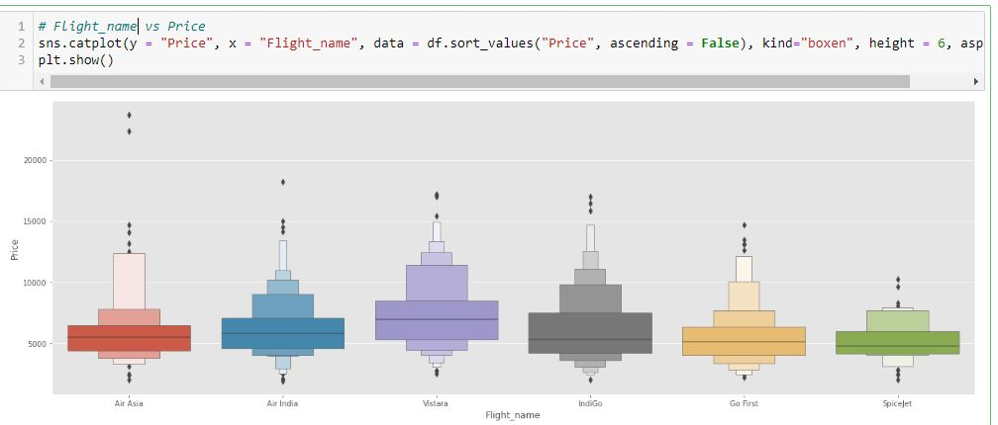
Flight Name

Slide 12
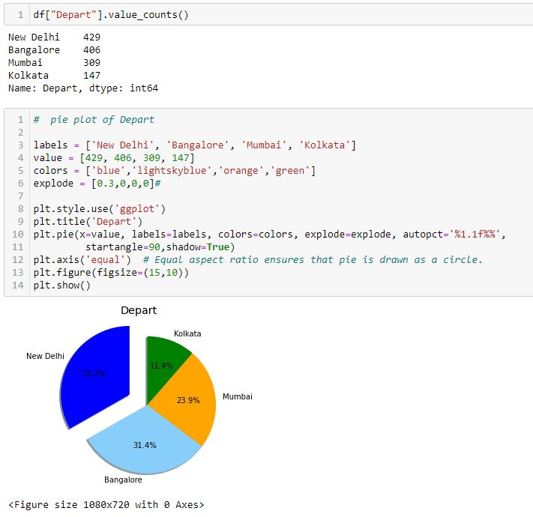
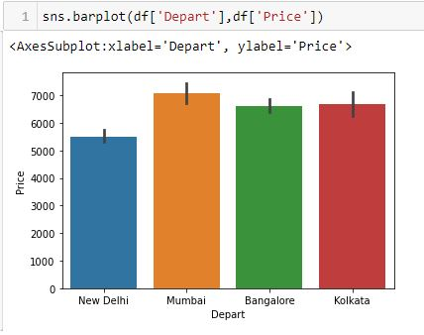
Departure

Slide 13
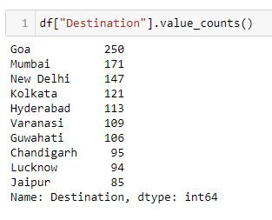
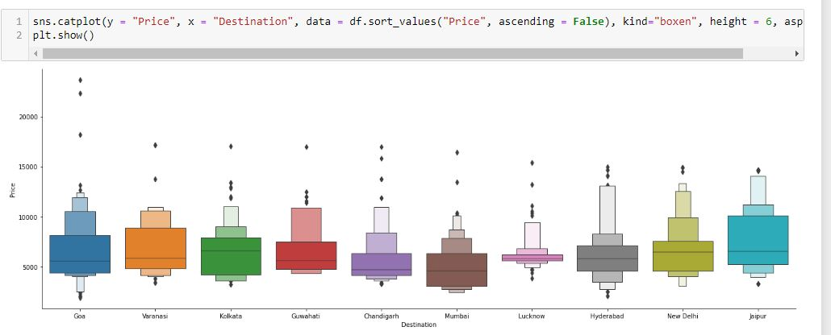
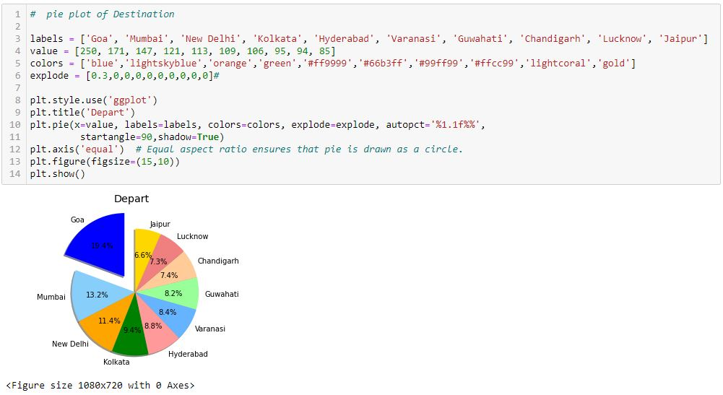
Destination

Slide 14
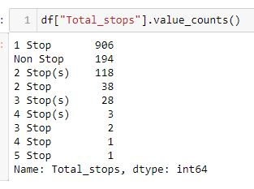
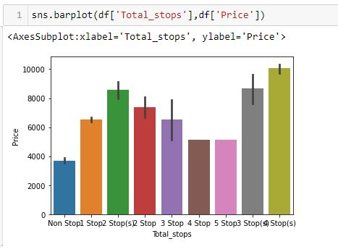
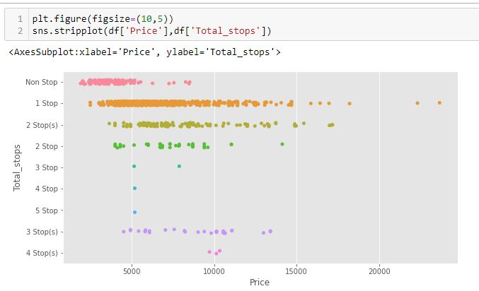
Total stops

Slide 15
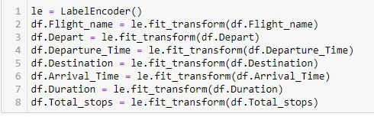
Label Encoder

Slide 16
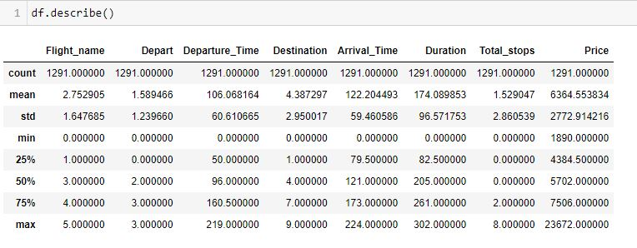
Describe columns

Slide 17
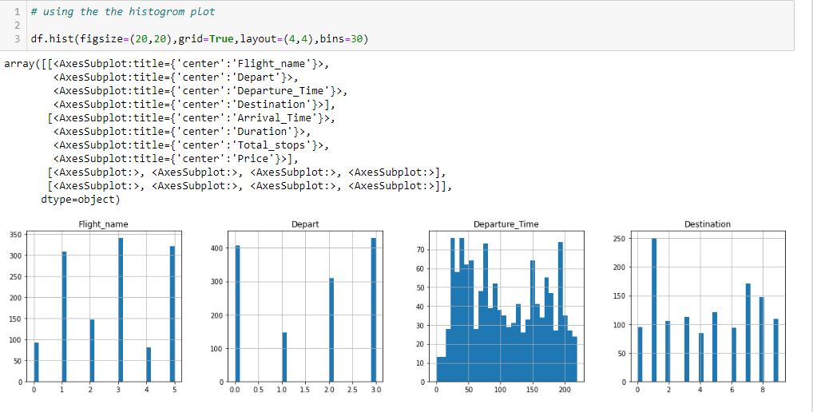
Histogram plot

Slide 18
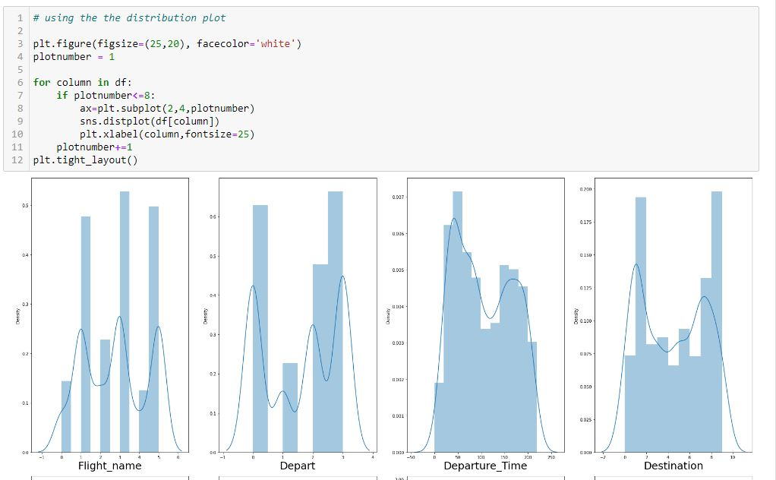
Distribution Plot

Slide 19
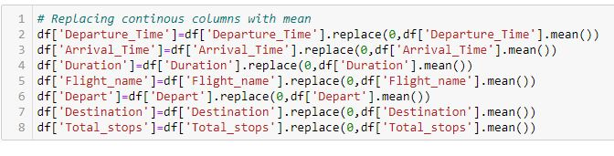
Replacing continuous columns

Slide 20
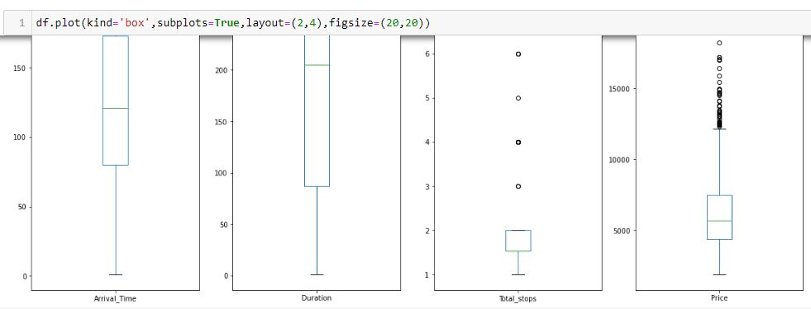
Box Plot

Slide 21
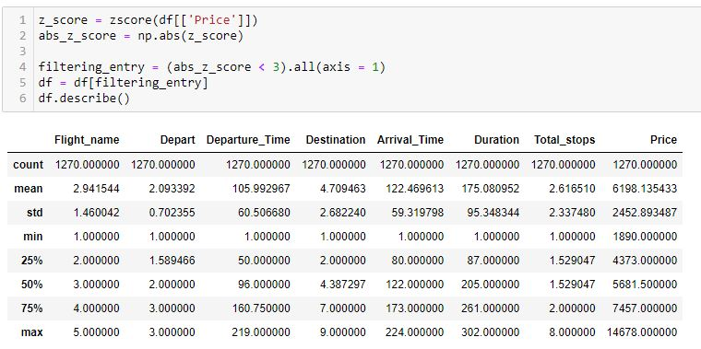
Zscore

Slide 22
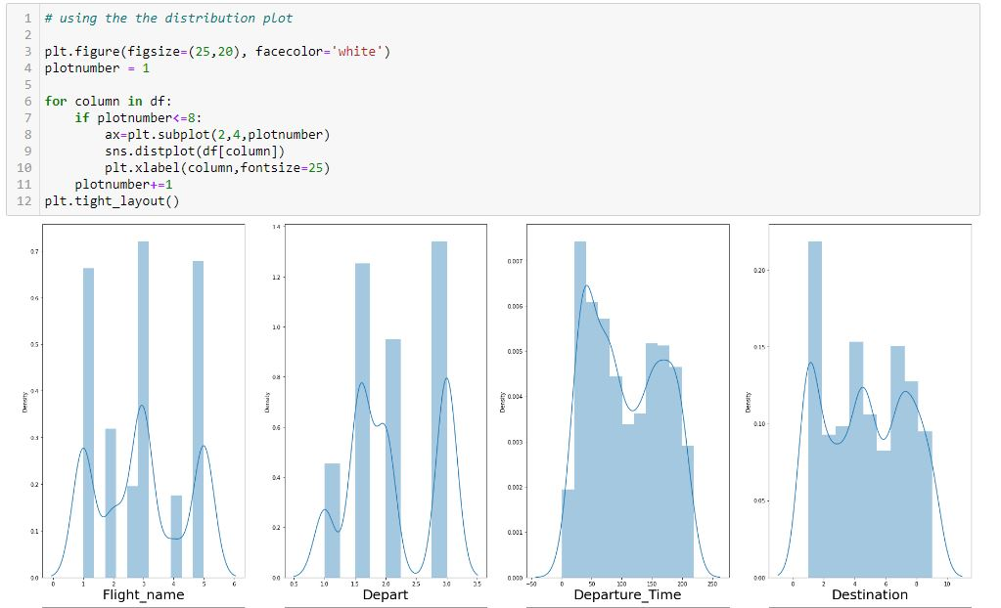
After Removing Skewness using Distribution Plot

Slide 23
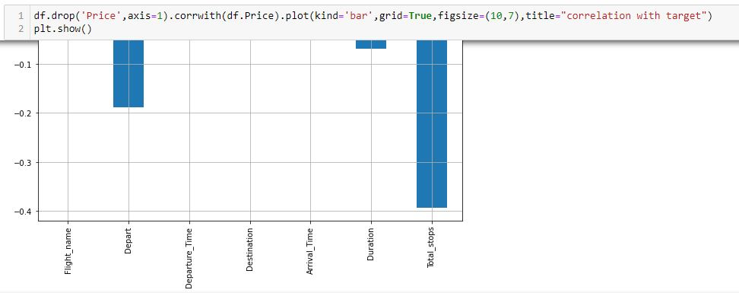
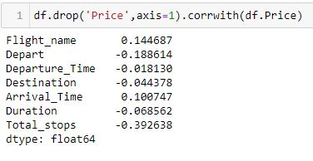
Finding correlation of features vs target using corrwith

Slide 24
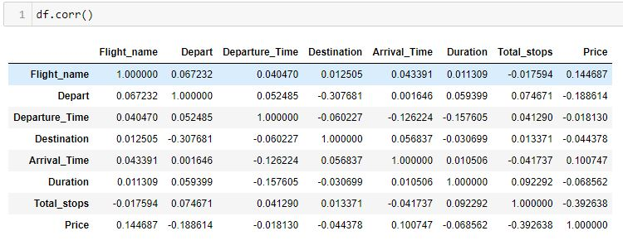
Correlation

Slide 25
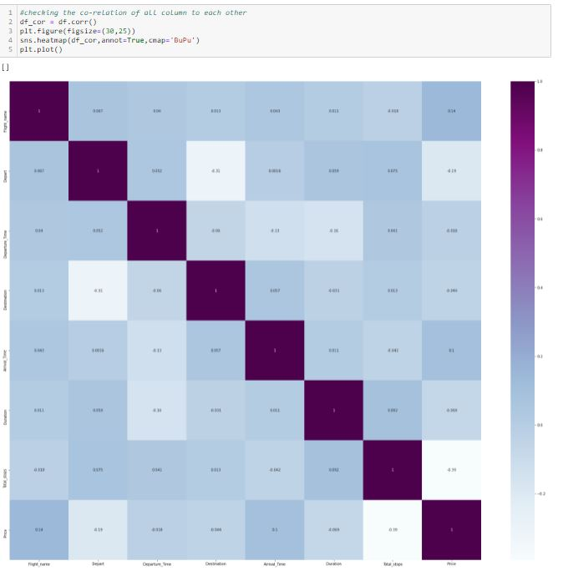
Heat map

Slide 26
Machine Learning

Slide 27

Dividing the dataset

Slide 28
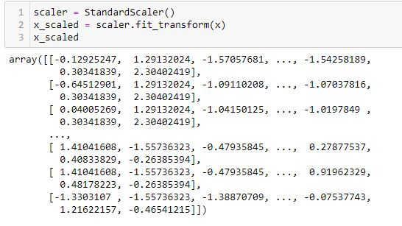
Standard Scaler

Slide 29
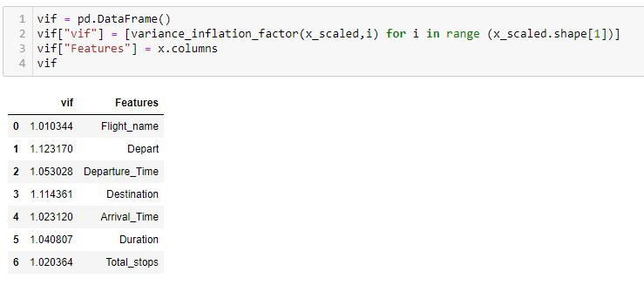
VIF - Variance Inflation Factor

Slide 30
Train Test Split

Slide 31
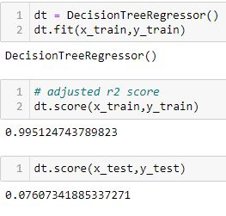
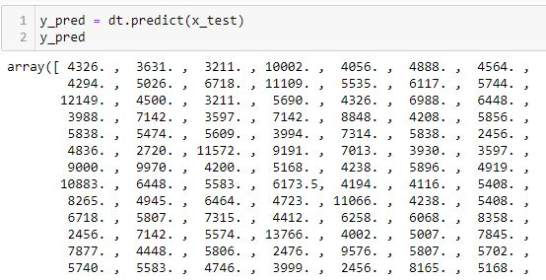
Decision Tree Regressor

Slide 32
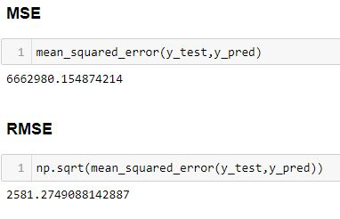
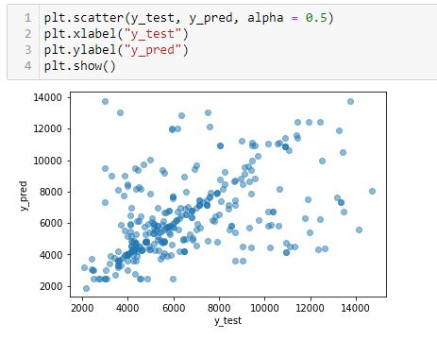
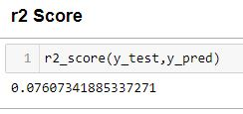
Accuracy Score of Decision Tree

Slide 33
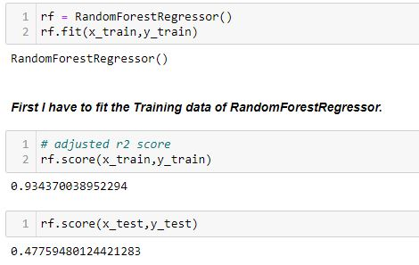
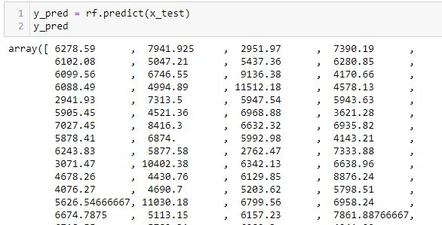
Random Forest Regressor

Slide 34
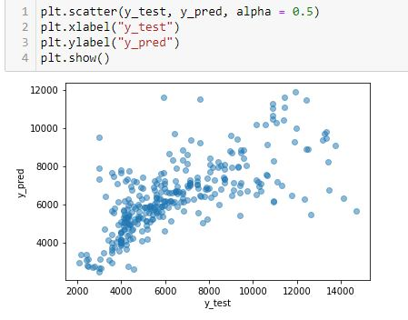
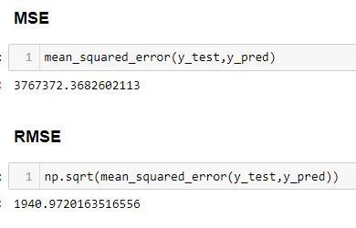
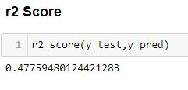
Accuracy Score of Random Forest Regressor

Slide 35
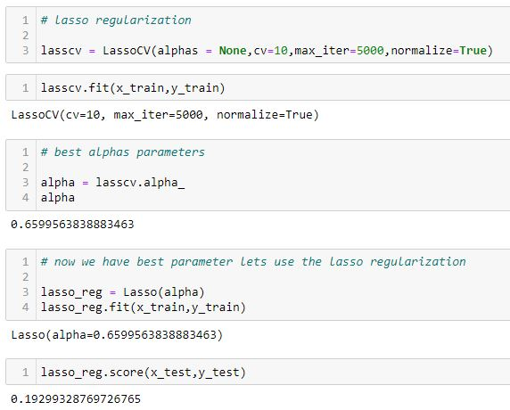
Lasso Regularization

Slide 36
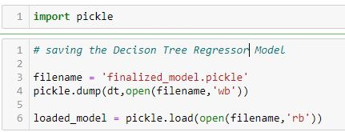
Saving Best Model

Slide 37
Interpretation of the Results
I have used visualization tool such as cat Plot and Bar Plot to understand the data in a better way.
I used describe method for five-point summary analysis and also found the number of rows and columns in dataset.
I have done the model building with 2 algorithms and the best model is Decision Tree Regressor with an accuracy score of 76.07%

Slide 38
CONCLUSION
I’ll briefly discuss how I approached this problem of predicting flight price prediction.
a) I have flight price prediction dataset from which I had to extract information.
b) I have done 1 label as the dataset speaks:
Price
c) I had used pandas library to read the Dataset which provide me to explore & visualize the Data properly based on Rows & Columns.
d) After from all datasets, I preprocessed the data using replacing all zeros and filling all missing values.
e) I did exploratory data analysis on main data frame and tried to see all visualizations.
f) Based on visualization knowledge, I use various EDA TECHNIQUES to plot the graphs and Box Plot.
g) I use VIF and Standard Scalar to scaled the data and by VIF I make a relationship between Features & Features.
h) After from all these i split the Features & Labels into 2 parts.
i) On this data, I have applied our machine learning models such as Random Forest Repressor and Decision Tree Regressor According to the above 4 model prediction the best model is Decision Tree Regressor - 76.07%.

